Slide 1
Jermyn Borough Council Meeting
6/15/2023

Slide 2

Meeting Agenda
JUNE 15,2023
CALL TO ORDER
PLEDGE OF ALLEGIANCE
ROLL CALL
PREVIOUS MEETING MINUTES
TREASURER REPORT/BILLS PAYABLE
SECRETARY REPORT
CORRESPONDENCE
PUBLIC COMMMENT
PROFESSIONAL REPORTS-POLICE, FIRE,SOLICITOR,ZONING,ENGINEER,TAX COLLECTOR,MAYOR
COMMITTEE REPORTS-SAFETY, PLANNING,FINANCE,SHADE TREE,REC,MS4,DPW
PAVE CUT ORDINANCE
WOODLANDS SEWER PROJECT
DPW GARAGE FLOOR
PENSION AUDIT
MS4
EXECUTIVE SESSION-PERSONNEL/LEGAL MATTERS
NEW BUSINESS

Slide 3
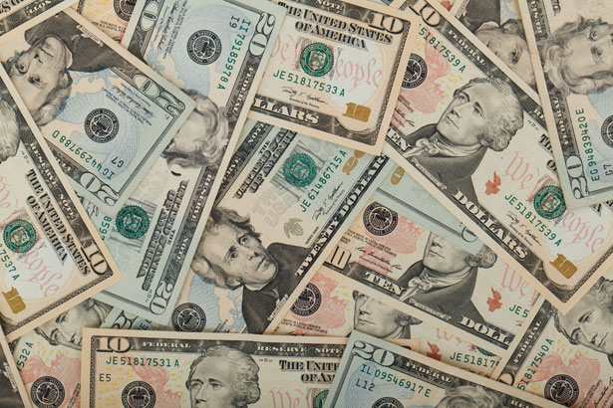
Treasurer’s report
6/15/2023
ASSETS
Checking/Savings
American Rescue Plan Fund 135,716.78
Capital Reserve - DPW 10,728.61
Capital Reserve - Police 5,154.82
Crime Watch Fund 222.69
General Fund - Community 282,290.08
General Fund - FNB 7,613.56
Holiday Lights Fund 1,459.09

Slide 4
Treasurer’s report
Investment - General Fund 1,032.48
Investment - Liquid Fuels 22,732.96
Investment - Paving Fund 1,043.21
Investment - Recycling 114.04
Investment - Refuse 162.60
Liquid Fuels - FNB 54,077.67
Petty Cash 223.00
Recreations Fund 26,721.85
Recycling - Community 1,926.07
Refuse Checking - FNB 239,718.08
Total Checking/Savings 790,937.59

Slide 5
Treasurer’s report
200000 · Accounts Payable 6,463.31
Long Term Debt 239,311.49

Slide 6


